Slide 1
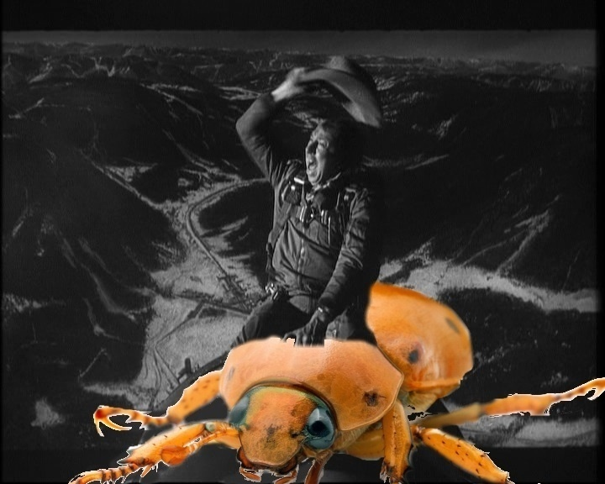
Picture Courtesy of: Prof. Sarah Ford, M.A. (a.k.a. Mrs. Matthew Hertz)
How I Learned to Stop Worrying & Love the Bug

Slide 2
Announcements
Course focused on software engineering concepts
“Make cool stuff” nice, but already know capable of this
Trying to develop experience & skills on important topics
Rubric (& scores) reflect emphasis; efforts should follow
Even for 1st sprint, project grows around user stories
Write many more stories than sprint will complete
Improve grade by checking stories written correctly
Create & use tasks to complete work for each sprint
Use acceptance tests for working product

Slide 3
Secret of Good Code

Slide 4
Secret of Good Code
Good Code Works

Slide 5
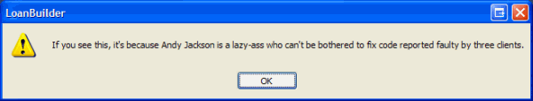
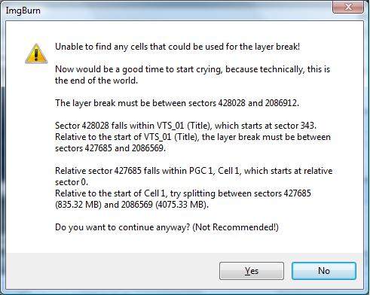
Good Code Works

Slide 6
Questions For Testing
What is correct?
Who gets to decide?
How do they know?
How To Document It Works?
Notes:
Apologize if this gets a bit philosophical

Slide 7
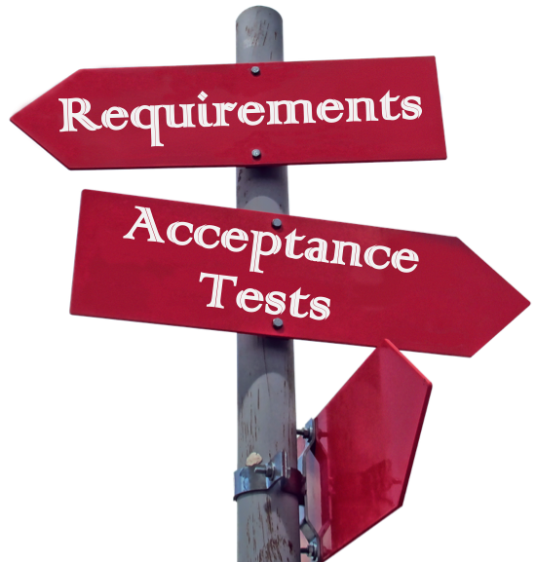
Questions For Testing
What is correct?
How To Document It Works?
Notes:
Crossroads photo added to the public domain by its photographer, JanBaby (https://pixabay.com/en/users/JanBaby-3005373/).
Original image is available at: https://cdn.pixabay.com/photo/2017/02/01/17/06/signpost-2030781_1280.png

Slide 8
Who Gets to Decide?
Original Author
Testing-Focused Member
Deadline-focused
Ego-driven
Assumes correct
Rewarded when work added to product
Quality-focused
Ego-driven
Assumes incorrect
Rewarded when product has no bugs
Notes:
Given this, think about what tests would actually look like…

Slide 9
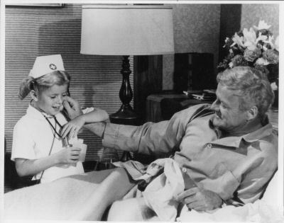
Tests We Usually Write

Slide 10

Tests We Should Write

Slide 11

Tests We Should Write
Assume Bugs Exist

Slide 12
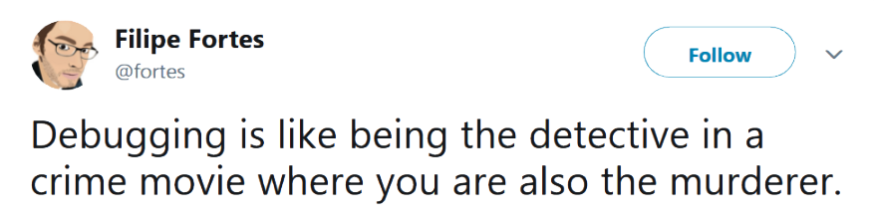
Write Code For Testing
Quality of product decided by testing
Testing properties targeted when writing code

Slide 13
Write Code For Testing
Quality of product decided by testing
Testing properties targeted when writing code
Ultimately, you have a very simple choice

Slide 14

Write Code For Testing
Quality of product decided by testing
Testing properties targeted when writing code
Ultimately, you have a very simple choice
or

Slide 15
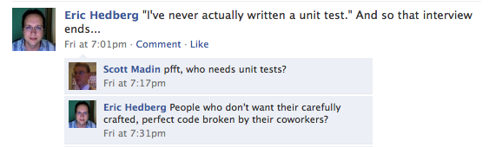
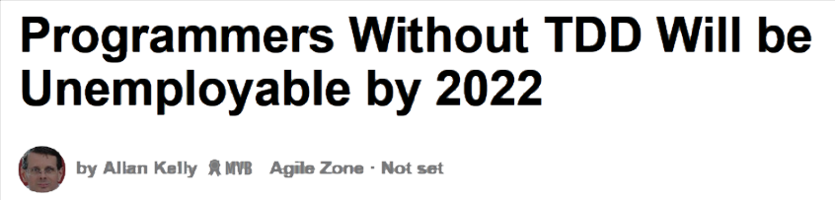
Test-Driven Development (TDD)
Very popular technique developing software

Slide 16
Test-Driven Development (TDD)
Very popular technique developing software
Greatly increases programmer productivity
Happier programmers also found when using TDD
Requires very different approach to coding
Write tests BEFORE begin implementation process
Write stubs (but no code) for class & methods
Knowing correct outputs, write tests to check
Implement methods to pass your tests (& check often)

Slide 17

Common Objection To TDD
But… How could I write tests
before I know what the
method does?

Slide 18

Smart Programmer Responds…
How could you write the code
before you know what the
method must do?

Slide 19
TDD Objections
Feels weird to start with tests when you first try…
.. but objections reflect poor habits checking code
Know method’s outcomes when starting to write…
… but you may not know how it will be done

Slide 20
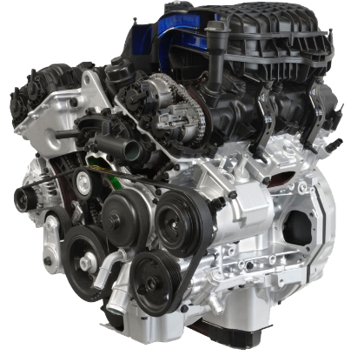
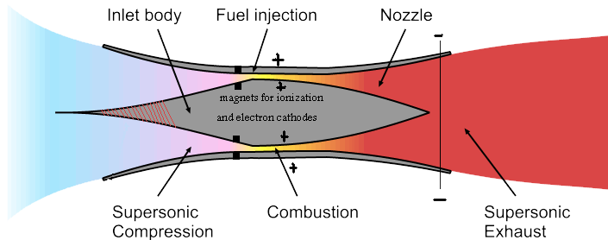
Thought Experiment
Have new engine uses 100x less gas
New power generation method provides this boost
Of the following which test do you want:
Belts and axels moved identically with new engine
New engine still uses same carburetor & pistons

Slide 21
TDD Key Concept
Check method’s results NOT method’s processes

Slide 22
Why TDD Helps
Many benefits when test cases created first
Clarify what method does so coding becomes easier
Since written for tests, methods become easier to fix
Know when code done by checking if tests pass
Studies have found that TDD simplifies debugging
Know when bug created by running tests regularly
Tests start to fail after writing 1 line: bug on that line
Bugs… somewhere(?) when hours pass before testing

Slide 23
Unit Testing Library
Most languages have xUnit library for unit testing
Tests written in language so can run anywhere
Strong support that make writing tests very easy
Supported by most IDEs (e.g., Eclipse, IntelliJ, BlueJ)
Started with Java – JUnit still gold standard for testing
Automation important to allow frequent testing
Testing easy – just select “Run As…” “JUnit test”
Green means good – checking results also very easy
Easy to see problems – see red when tests fail

Slide 24
JUnit Test Cases Format
Most often write test class for each class
Identical to other classes; usually named ____Test
As regular class, can use inheritance & have fields
Inheritance & fields not required like any Java class
Since ver. 4.0, JUnit’s annotations identify tests
Extra information added to show method is test case
Annotation added immediately before method

Slide 25
JUnit Test Cases Format
Most often write test class for each class
Identical to other classes; usually named ____Test
As regular class, can use inheritance & have fields
Inheritance & fields not required like any Java class
Since ver. 4.0, JUnit’s annotations identify tests
Extra information added to show method is test case
Annotation added immediately before method
No code or comments between annotation & method

Slide 26
Statements Performing Checks
assertEquals(X expected, X actual)
assertEquals(float exp, float act, float tol)
assertEquals(double exp, double act,double tol)
assertTrue(boolean test)
assertFalse(boolean test)
assertNull(Object objTest)
assertNotNull(Object objTest)
fail()

Slide 27
JUnit Annotations
Loop until all test cases in class are executed
JUnit executes all methods marked @Before
Optional methods initialize any data before each test
Run exactly 1 method labeled @Test executed
Pass if no crashes & no incorrect asserts occur during test
Fails & stops running when assert____ does not pass
Executes all methods marked @After
Also optional, cleans mess made by @Before

Slide 28
Statements Performing Checks
assertEquals(X expected, X actual)
assertEquals(float exp, float act, float tol)
assertEquals(double exp, double act,double tol)
assertTrue(boolean test)
assertFalse(boolean test)
assertNull(Object objTest)
assertNotNull(Object objTest)
fail()
@Test method should result in calling 1 or more assert* statement.
Assertion must not hold for method to fail.

Slide 29
Writing Test Methods
Test methods MUST have @Test annotation
Non-static, void methods only for JUnit to work
By same logic, test methods cannot have parameters
Uses normal code to write these test methods
Just normal methods; can contain any legal Java code
Conditionals and loop statements occasionally included
Can instantiate objects and call methods on objects
Other methods can use assert___ & be called by tests

Slide 30
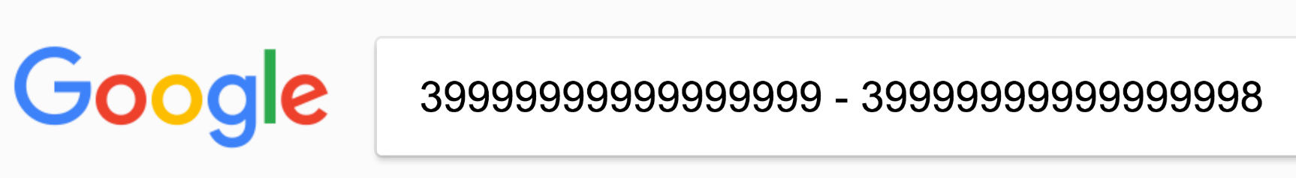
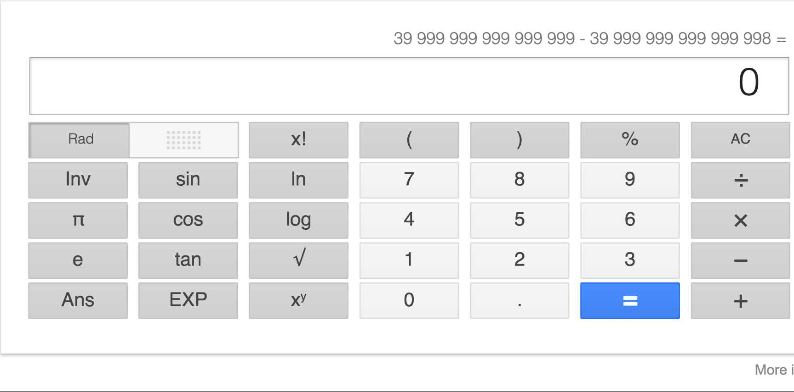
assertEquals With Decimals
Computers actually very bad at math:

Slide 31
assertEquals With Decimals
Computers actually very bad at math:

Slide 32
Math Checks With Decimals
Computers actually very bad at math
Decimal numbers hard & imprecision always created
Not limited to computers: can you write ²/₃ as decimal?

Slide 33
Math Checks With Decimals
Computers actually very bad at math
Decimal numbers hard & imprecision always created
Not limited to computers: can you write ²/₃ as decimal?
Must specify tolerance for decimal comparisons
float or double equal if difference below tolerance
assertEquals(float expect, float act, float tolerance) assertEquals(double expect, double act, double tolerance)

Slide 34
Tests Key Concept #1
Include tolerance (allowed rounding error) for floating point arithmetic checks

Slide 35
Math Checks With Decimals
Examples of this in use:
float act = 0.2;
assertEquals(0.3, act, 0.01);
assertEquals(10.1, act, 10.00);
Tolerance depends on problem & precision needed
If unclear, just pick reasonable value (I use 0.001)

Slide 36
Test Method Outline
Declare variable(s), create objects, & prep inputs
Call the method being tested
Use specification to verify returned value correct
Check fields for changes matching requirements
Should also verify other fields did not change
Assert array & object arguments also correct

Slide 37
Class To Be Tested
public class Operational { private int a, b; public Operational(int fst, int snd) { a = fst; b = snd;
} public String multiply() { int product = a * b; return “Product is ”+product; } public String sum() { return “Sum is ”+a+b; } }

Slide 38
Class To Be Tested
public class Operational { private int a, b; public Operational(int fst, int snd) { a = fst; b = snd;
} public String multiply() { int product = a * b; return “Product is ”+product; } public String sum() { return “Sum is ”+a+b; } }
This concatenates a & b (like Strings) rather than adding them. So 3 + 2 will be 32 and not 5.
Our tests need to find this!

Slide 39
Starting Test Cases
Traditionally, test class adds “Test” to class name
Each case is method having @Test annotation
public class OperationalTest { @Test public void testMult0() { Operational xByZero = new Operational(3, 0); Operational zeroByX = new Operational(0, 17); assertEquals(“Product is 0”, xByZero.multiply()); assertEquals(“Product is 0”, zeroByX.multiply()); }

Slide 40
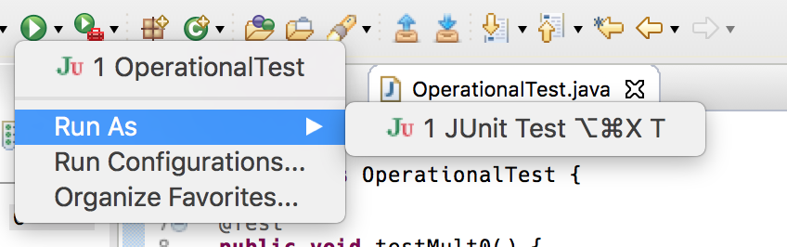
Starting Test Cases
Traditionally, test class adds “Test” to class name
Each case is method having @Test annotation
public class OperationalTest { @Test public void testMult0() { Operational xByZero = new Operational(3, 0); Operational zeroByX = new Operational(0, 17); assertEquals(“Product is 0”, xByZero.multiply()); assertEquals(“Product is 0”, zeroByX.multiply()); }

Slide 41
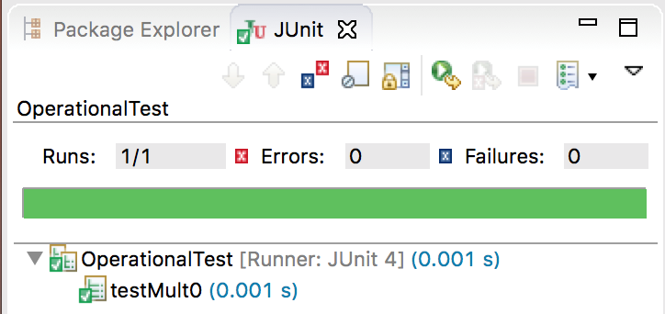
Starting Test Cases
Traditionally, test class adds “Test” to class name
Each case is method having @Test annotation
public class OperationalTest { @Test public void testMult0() { Operational xByZero = new Operational(3, 0); Operational zeroByX = new Operational(0, 17); assertEquals(“Product is 0”, xByZero.multiply()); assertEquals(“Product is 0”, zeroByX.multiply()); }

Slide 42
Bad Tests to Write
Only get to know test failed with assertTrue()
@Test public void yuckyButLegal() { Operational xByOne = new Operational(-2, 1); Operational oneByX = new Operational(1, 4); assertTrue(xByOne.multiply() .equals(“Product is 2”)); }

Slide 43
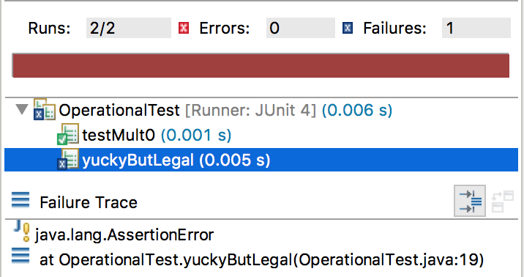
Bad Tests to Write
Only get to know test failed with assertTrue()
@Test public void yuckyButLegal() { Operational xByOne = new Operational(-2, 1); Operational oneByX = new Operational(1, 4); assertTrue(xByOne.multiply() .equals(“Product is 2”)); }

Slide 44
Better Tests to Write
Get more detailed results with assertEquals()
@Test public void muchImproved() { Operational xByOne = new Operational(-2, 1); Operational oneByX = new Operational(1, 4); assertEquals(“Product is 2”, xByOne.multiply()); }

Slide 45
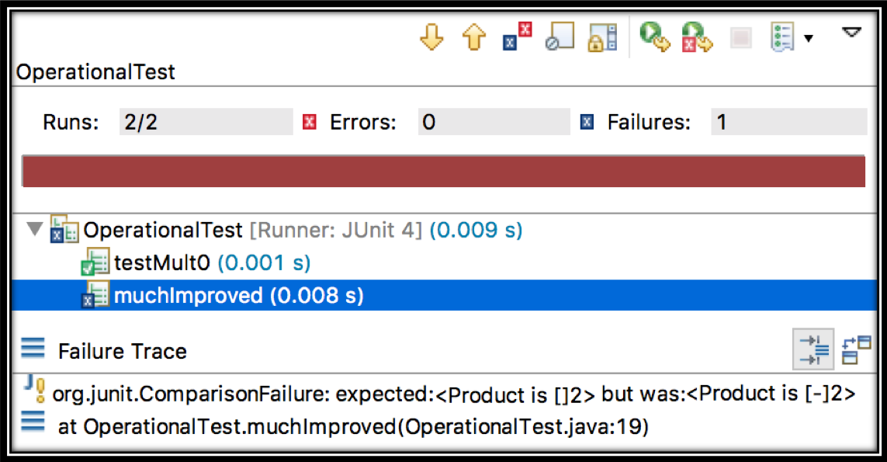
Better Tests to Write
Get more detailed results with assertEquals()
@Test public void muchImproved() { Operational xByOne = new Operational(-2, 1); Operational oneByX = new Operational(1, 4); assertEquals(“Product is 2”, xByOne.multiply()); }

Slide 46
Tests Key Concept #2
Use assertTrue() & assertFalse() only for boolean values & properties

Slide 47
More Test Gotchas
Must be certain assert___ testing YOUR code
@Test public void whatAmITesting() { Operational xByOne = new Operational(-2, 1); assertEquals(“Product is -2”, “Product is ” + (-2 * 1)); }

Slide 48
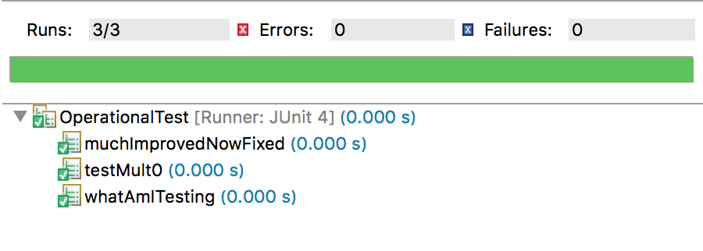
More Test Gotchas
Must be certain assert___ testing YOUR code
@Test public void whatAmITesting() { Operational xByOne = new Operational(-2, 1); assertEquals(“Product is -2”, “Product is ” + (-2 * 1)); }

Slide 49
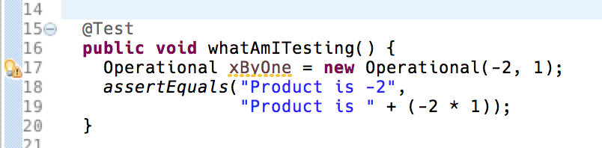
More Test Gotchas
Must be certain assert___ testing YOUR code
@Test public void whatAmITesting() { Operational xByOne = new Operational(-2, 1); assertEquals(“Product is -2”, “Product is ” + (-2 * 1)); }

Slide 50
More Test Gotchas
Will this pass?
@Test public void passingIsNotFailing() { Operational xByOne = new Operational(-2, 1); xByOne.sum(); }

Slide 51
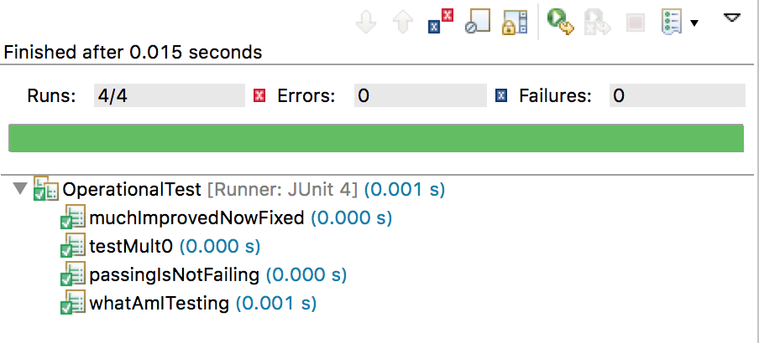
More Test Gotchas
Will this pass?
@Test public void passingIsNotFailing() { Operational xByOne = new Operational(-2, 1); xByOne.sum(); }

Slide 52

More Test Gotchas
Will this pass?
@Test public void passingIsNotFailing() { Operational xByOne = new Operational(-2, 1); xByOne.sum(); }

Slide 53
Tests Key Concept #3
Every @Test method should execute
AT LEAST 1 assert_____()

Slide 54
Hardcode Your Checks
Hardcode assert___ expected value if it is possible
@Test public void shouldNotPassButDoesPass() { Operational xByOne = new Operational(-2, 1); assertEquals(“Sum is ” + -2 + 1, xByOne.sum()); }

Slide 55
Hardcode Your Checks
Hardcode assert___ expected value if it is possible
@Test public void shouldNotPassButDoesPass() { Operational xByOne = new Operational(-2, 1); assertEquals(“Sum is ” + -2 + 1, xByOne.sum()); }

Slide 56
Hardcode Your Checks
Hardcode assert___ expected value if it is possible
@Test public void nowFindsBug() { Operational xByOne = new Operational(-2, 1); assertEquals(“Sum is -1”, xByOne.sum()); }

Slide 57
Assumptions Deadly
Often make assumptions when writing code
True writing code and still true writing test cases
Passing ≠ correct; could be no tests were run
May not check what you think; care needed writing tests
Tests should be written & run before coding
Tests must fail, since code has not yet been written!
Before wasting time, always check assumptions

Slide 58
Assumptions Deadly
Often make assumptions when writing code
True writing code and still true writing test cases
Passing ≠ correct; could be no tests were run
May not check what you think; care needed writing tests
Tests should be written & run before coding
Tests must fail, since code has not yet been written!
Before wasting time, always check assumptions

Slide 59
Evaluating Test Efforts
Develop tests with detailed look at the algorithm
Test coverage discussed often by people, but…
… coverage can be measured many ways
Statement coverage Run each statement at least once
Branch coverage Run each branch at least once
Path coverage Run each possible branch combination at least once
Detail Increases

Slide 60
Coverage Measures
2
4
1
3
5
All Statements: | 1, 2, 3, 4, 5
All Branches: | 1, 2, 3, 4, 5 1, 3, 5
All Paths: | 1, 2, 3, 4, 5 1, 2, 3, 5 1, 3, 4, 5 1, 3, 5
Notes:
Point out that all paths is just not really possible…
State that we can check for all statements testing (e.g., the minimum acceptable level) in Eclipse directly!

Slide 61
How To Write Tests
Cannot prove there are no bugs
Notes:
Picture is of Edsgar Dijkstra of Dijkstra’s algorithm (and just about everything else not done by Knuth) fame.

Slide 62
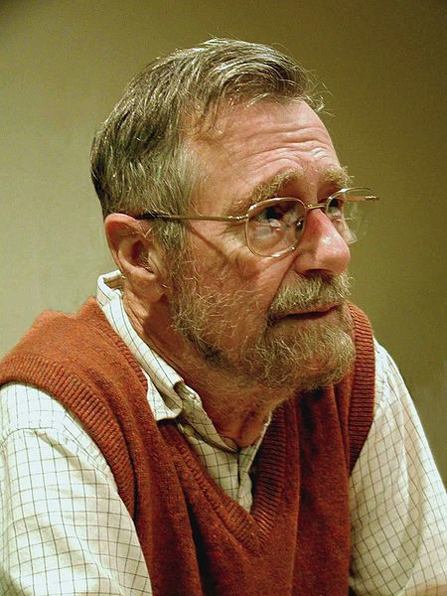
How To Write Tests
Cannot prove there are no bugs
Testing shows the presence, not the absence of bugs
Notes:
Picture is of Edsgar Dijkstra of Dijkstra’s algorithm (and just about everything else not done by Knuth) fame.

Slide 63
How To Write Tests
Cannot prove there are no bugs
Can only show no bugs exist on those tests
Testing shows the presence, not the absence of bugs
Notes:
Picture is of Edsgar Dijkstra of Dijkstra’s algorithm (and just about everything else not done by Knuth) fame.

Slide 64
What To Test & Why
20% of code has 80% of bugs
Notes:
Limited budgets require focused, not full, testing
Add some tests for typical cases/paths, but this is probably well thoughtout & planned
Developers & Alpha testers will find all the obvious issues when they run the program
Focus on the alternate paths & odd branches – this is what your customers will do
(Animation 1) More complex areas have more places for things to hide and harder to produce perfectly accurately
(Animation 2) Join points can create unexpected problems – bridge in Laufenburg Germany/Switz. which went bad because the two countries account for Sea Level differently
(Animation 3) They actually meant lap desks – the problem was really that terminology has changed!
(Animation 4) I _always_ advertise price increases

Slide 65

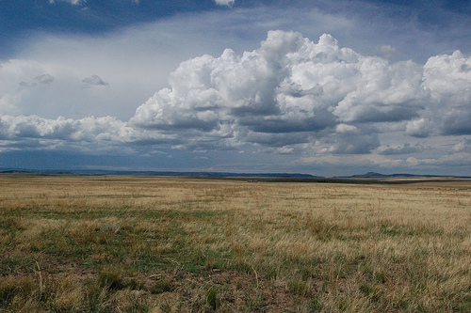
What To Test & Why
20% of code has 80% of bugs
Modules that are most complex, intricate, or detailed
versus
Notes:
Limited budgets require focused, not full, testing
Add some tests for typical cases/paths, but this is probably well thoughtout & planned
Developers & Alpha testers will find all the obvious issues when they run the program
Focus on the alternate paths & odd branches – this is what your customers will do
(Animation 1) More complex areas have more places for things to hide and harder to produce perfectly accurately
(Animation 2) Join points can create unexpected problems – bridge in Laufenburg Germany/Switz. which went bad because the two countries account for Sea Level differently
(Animation 3) They actually meant lap desks – the problem was really that terminology has changed!
(Animation 4) I _always_ advertise price increases

Slide 66
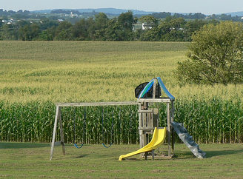
What To Test & Why
20% of code has 80% of bugs
Modules that are most complex, intricate, or detailed
Locations where expectations of data might differ
versus
Notes:
Limited budgets require focused, not full, testing
Add some tests for typical cases/paths, but this is probably well thoughtout & planned
Developers & Alpha testers will find all the obvious issues when they run the program
Focus on the alternate paths & odd branches – this is what your customers will do
(Animation 1) More complex areas have more places for things to hide and harder to produce perfectly accurately
(Animation 2) Join points can create unexpected problems – bridge in Laufenburg Germany/Switz. which went bad because the two countries account for Sea Level differently
(Animation 3) They actually meant lap desks – the problem was really that terminology has changed!
(Animation 4) I _always_ advertise price increases

Slide 67
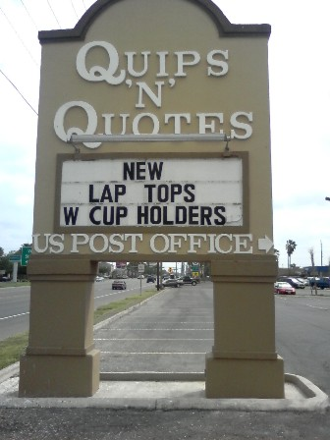
What To Test & Why
20% of code has 80% of bugs
Modules that are most complex, intricate, or detailed
Locations where expectations of data might differ
Code in transition: frequently changed modules
Notes:
Limited budgets require focused, not full, testing
Add some tests for typical cases/paths, but this is probably well thoughtout & planned
Developers & Alpha testers will find all the obvious issues when they run the program
Focus on the alternate paths & odd branches – this is what your customers will do
(Animation 1) More complex areas have more places for things to hide and harder to produce perfectly accurately
(Animation 2) Join points can create unexpected problems – bridge in Laufenburg Germany/Switz. which went bad because the two countries account for Sea Level differently
(Animation 3) They actually meant lap desks – the problem was really that terminology has changed!
(Animation 4) I _always_ advertise price increases

Slide 68
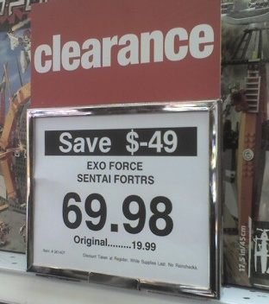
What To Test & Why
20% of code has 80% of bugs
Modules that are most complex, intricate, or detailed
Locations where expectations of data might differ
Code in transition: frequently changed modules
Any place where program requires user input
Notes:
Limited budgets require focused, not full, testing
Add some tests for typical cases/paths, but this is probably well thoughtout & planned
Developers & Alpha testers will find all the obvious issues when they run the program
Focus on the alternate paths & odd branches – this is what your customers will do
(Animation 1) More complex areas have more places for things to hide and harder to produce perfectly accurately
(Animation 2) Join points can create unexpected problems – bridge in Laufenburg Germany/Switz. which went bad because the two countries account for Sea Level differently
(Animation 3) They actually meant lap desks – the problem was really that terminology has changed!
(Animation 4) I _always_ advertise price increases

Slide 69
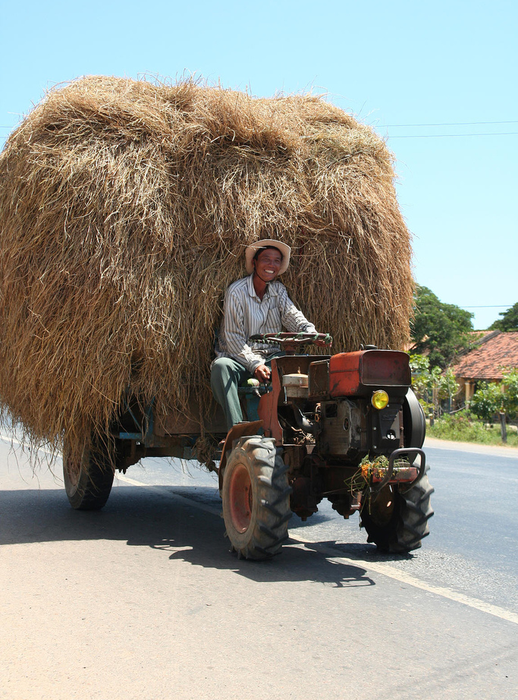
What Do We Gain?
Go from this…

Slide 70

What Do We Gain?
Go from this…
… to this

Slide 71

Picture Courtesy of: Prof. Sarah Ford, M.A. (a.k.a. Mrs. Matthew Hertz)
How I Learned to Stop Worrying & Love the Bug

Slide 72
How To Write Tests
Cannot prove there are no bugs
Can only show no bugs exist on those tests
Testing shows the presence, not the absence of bugs
Notes:
Picture is of Edsgar Dijkstra of Dijkstra’s algorithm (and just about everything else not done by Knuth) fame.

Slide 73
What To Test & Why
20% of code has 80% of bugs
Modules that are most complex, intricate, or detailed
Locations where expectations of data might differ
Code in transition: frequently changed modules
Any place where program requires user input
Focus testing efforts to concentrate on these bugs
Tests (& testing) expensive & simpler tools for easy code
Automation key, since errors often occur at join points
Notes:
Limited budgets require focused, not full, testing
Add some tests for typical cases/paths, but this is probably well thoughtout & planned
Developers & Alpha testers will find all the obvious issues when they run the program
Focus on the alternate paths & odd branches – this is what your customers will do
(Animation 1) More complex areas have more places for things to hide and harder to produce perfectly accurately
(Animation 2) Join points can create unexpected problems – bridge in Laufenburg Germany/Switz. which went bad because the two countries account for Sea Level differently
(Animation 3) They actually meant lap desks – the problem was really that terminology has changed!
(Animation 4) I _always_ advertise price increases

Slide 74
Tests Key Concept #4
Assume the worst: Focus testing on unlikely situations

Slide 75
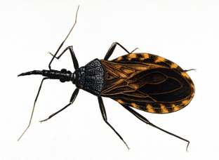
Input Tests
Two tests to consider when input is Object
Provide null as input since that often leads to crashes
null probably unlikely, so also check with real instance
Strings & Lists need more, since size matters
Important to test case when size is 0 (empty list or “”)
Testing on size of 1 provides easy debugging chance
Simplify longer examples with test with input size of 2
Test using larger size since that is the common case

Slide 76
Input Tests
Also have many common test cases for numbers
Input equal to 0 since it is special (especially division)
Simplify any debugging by using small input (1 or 2)
Test a negative number since easy to overlook
Assume bugs exist and check non-obvious case (like 11)
Force decimals for float or double values in method
Also should check on “magic numbers” for method
Numbers included in description (or, later, in the code)
Could also think to test values 1 higher & 1 lower, too

Slide 77
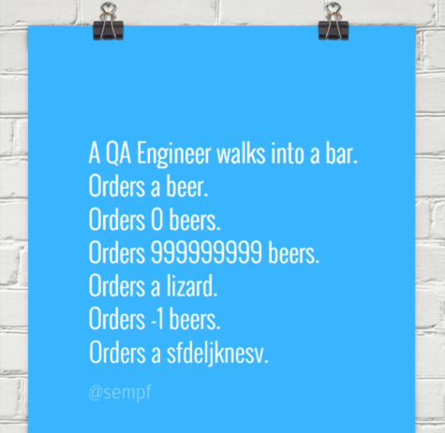
Input Tests

Slide 78
Where the Bugs Aren’t
In real world, some cases may not be worth testing
Must assume bugs exist so ideally test everything
Save time, do not change input to check same idea
No point in repeating tests unless results could differ
Electricity costs money; do not waste on identical tests
Pointless retesting case, test will not prove anything

Slide 79
Where the Bugs Aren’t
In real world, some cases may not be worth testing
Must assume bugs exist so ideally test everything
Save time, do not change input to check same idea
No point in repeating tests unless results could differ
Electricity costs money; do not waste on identical tests
Pointless retesting case, test will not prove anything

Slide 80
Where the Bugs Aren’t
In real world, some cases may not be worth testing
Must assume bugs exist so ideally test everything
Save time, do not change input to check same idea
Simple getters & setters easy, but check before commit

Slide 81

Where the Bugs Aren’t
In real world, some cases may not be worth testing
Must assume bugs exist so ideally test everything
Save time, do not change input to check same idea
Simple getters & setters easy, but check before commit
Focus on possibilities, do not check impossible cases

Slide 82
Good Tests
public class Stock { private double cost; // Constructor & getter simple & skipped for space // Decreases cost of a stock; delta is max. drop in cost // Returns updated value of cost public double reduceCost(double delta) { } // Even more code would be here, were this not an example for class
public class StockTest { @Test public void t1() { Stock ibm = new Stock(141.31); assertEquals(141.31, ibm.reduceCost(0), 0.001); assertEquals(141.31, ibm.getCost(),0.001); }

Slide 83
More Good Tests
public class Stock { private double cost; // Constructor & getter simple & skipped for space // Decreases cost of a stock; delta is max. drop in cost // Returns updated value of cost public double reduceCost(double delta) { } // Even more code would be here, were this not an example for class
public class StockTest { @Test public void t2() { Stock siri = new Stock(7.10); assertEquals(0.0, siri.reduceCost(8), 0.001); assertEquals(0.0, siri.getCost(),0.001); }
Notes:
Stock symbol ”Siri” is for SiriusXM not Apple.

Slide 84
Not a Good Test
public class Stock { private double cost; // Constructor & getter simple & skipped for space // Decreases cost of a stock; delta is max. drop in cost // Returns updated value of cost public double reduceCost(double delta) { } // Even more code would be here, were this not an example for class
public class StockTest { @Test public void t3() { Stock htz = new Stock(15.09); assertEquals(?????, htz.reduceCost(-100), 0.001); assertEquals(?????, htz.getCost(),0.001); }
Notes:
Hertz should have been hz (if you ask me)

Slide 85
Not a Good Test
public class Stock { private double cost; // Constructor & getter simple & skipped for space // Difference from cost at which people sold stock; delta is max. drop in cost // Returns updated value of cost public double reduceCost(double delta) { } // Even more code would be here, were this not an example for class
public class StockTest { @Test public void t3() { Stock htz = new Stock(15.09); assertEquals(?????, htz.reduceCost(-100), 0.001); assertEquals(?????, htz.getCost(),0.001); }
Notes:
Hertz should have been hz (if you ask me)

Slide 86
Tests Key Concept #4
Assume the worst: Focus testing on unlikely
(but not impossible) situations

Slide 87

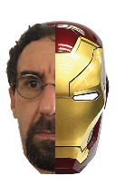
Why Use a Computer?
 | Computer | Professor
Memory | Huge (> 250GB) | Can’t remember which day it is
Computing speed | Fast (> 2 billion/second) | Slow (needs fingers & toes)
Takes direction | Does exactly as told | Leaves toilet seat up
Speed of updates | Nearly instantaneous | Still wears t-shirt from 1988
Ability to plan & reason | Cannot make plans; No reasoning skills; Lacks common sense | Makes (semi-)complicated plans; Good reasoning skills; Lacks common sense

Slide 88
Loop Testing Important
Small bugs in loops can create huge errors
Lots of time executing increases odds of hitting rare case
Often error only appears when results used, not in loop
Debugging often tricky, since many scenarios to test out
Run often + hard-to-debug == critical to test well
Finding bugs important, since quality depends on this
Knowing bugs exists useless; must also simplify fixes
So narrowing bug's cause just as needed as finding bug

Slide 89
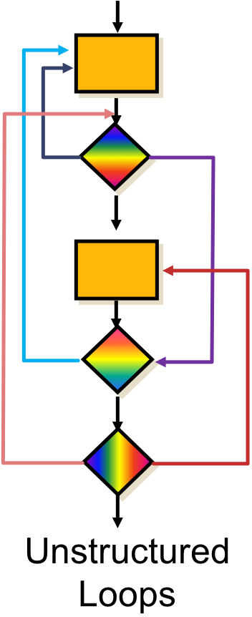
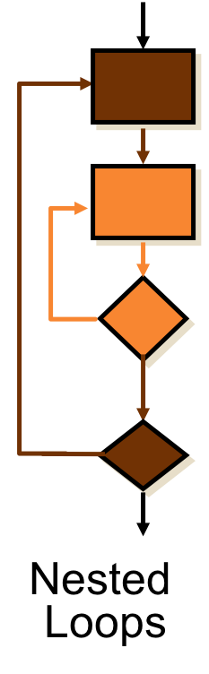
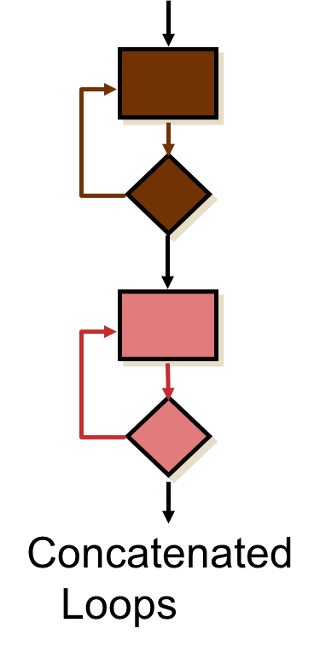
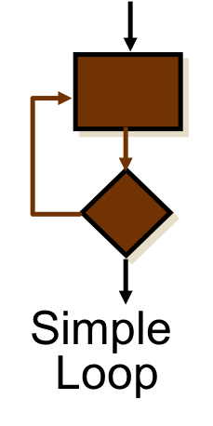
Types of Loops

Slide 90
Types of Loops

Slide 91

Simple Loop
For all simple loops, try inputs that:
Skip loop entirely
Make 1 pass through the loop
Make 2 passes through the loop
Make m passes through the loop, where (m > 2)
If loop executed at most n times, try inputs that:
Make n-1 & n passes through the loop

Slide 92
Types of Loops

Slide 93

Nested Loops
First test set runs all outer loops exactly once
Inner loop runs (min+1), average, (max-1) & max times
Then run all but two innermost loops exactly once
Inner loops run (min+1), average, (max-1) & max times
Tests should continue growing loop-by-loop

Slide 94
Types of Loops

Slide 95

Concatenated Loops
If loops are entirely independent
No conditions, variables, or values in common
Woo-hoo! Just perform single loop tests on each
Otherwise treat as nested loops & make life easier
Work as if the first loop is the outermost loops

Slide 96
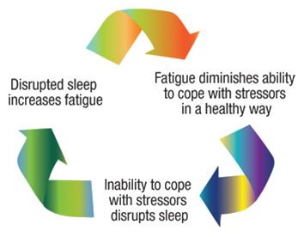

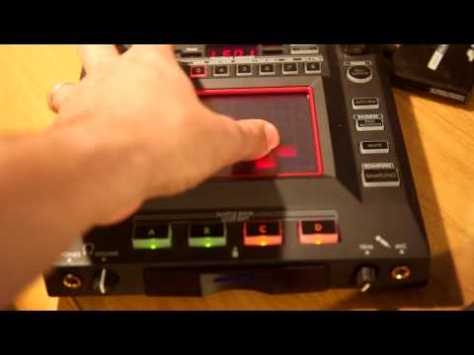
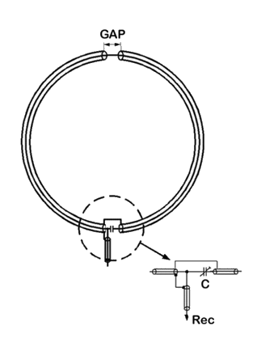
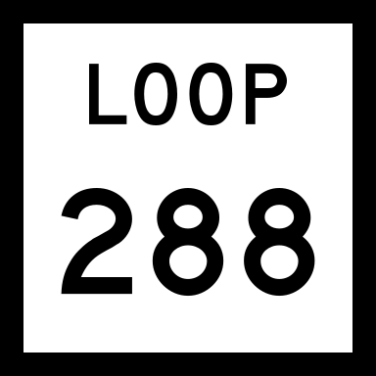
Types of Loops

Slide 97
Unstructured Loops
Figure out the process leading to this decision
Burn artifacts and code resulting in this abomination
Notes:
(Animate on terminate joke)

Slide 98
Unstructured Loops
Figure out the process leading to this decision
Burn artifacts and code resulting in this abomination
Anyone involved should terminated immediately
Notes:
(Animate on terminate joke)

Slide 99
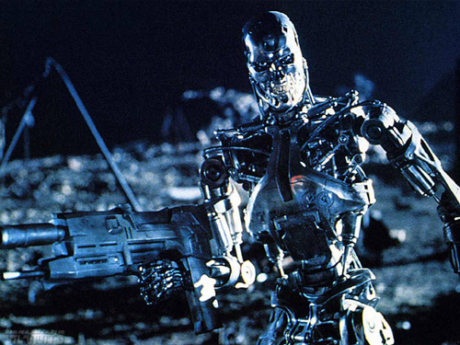
Unstructured Loops
Figure out the process leading to this decision
Burn artifacts and code resulting in this abomination
Anyone involved should terminated immediately
Notes:
(Animate on terminate joke)

Slide 100
Unstructured Loops
Figure out the process leading to this decision
Burn artifacts and code resulting in this abomination
Anyone involved should terminated immediately
ReWrite “missing” documents, starting from scratch
Notes:
(Animate on terminate joke)

Slide 101
Back-End Testing
Unit tests good for some tasks working on back-end
But what about tasks implementing front-end code?
User wants results and only knows what they can see
Correct results impossible if back-end fails unit tests
Back-end code very important so cannot skip tests
But invisible to user and client does not care about code

Slide 102

Back-End Testing
Unit tests good for some tasks working on back-end
But what about tasks implementing front-end code?
User wants results and only knows what they can ee
Correct results impossible if back-end fails unit tests
Back-end code very important so cannot skip tests
But invisible to user and client does not care about code

Slide 103

Front-End Testing
Need to test front-end tasks that display information
GUI classes can be checked against user stories
JUnit test cases less useful performing these tests
Automation lacks human touch; cannot check aesthetics

Slide 104
Front-End "Testing"
Worst approach: Clicking around & see what breaks
Simple & fast, but may not discover actual cause of bugs
Unrepeatable & slow when checking entire system
Done by developers, tends to follow expected uses

Slide 105

Front-End "Testing"
Worst approach: Clicking around & see what breaks
Simple & fast, but may not discover actual cause of bugs
Unrepeatable & slow when checking entire system
Done by developers, tends to follow expected uses

Slide 106
Front-End Testing
Better approach: Step-by-step script tests for errors
Low overhead & simple, but also easy to forget to run
Discover unexpected bugs by having testers run scripts
Good rules-of-thumb exist to find many common errors
List in task in ZenHub; many want files to hold scripts

Slide 107
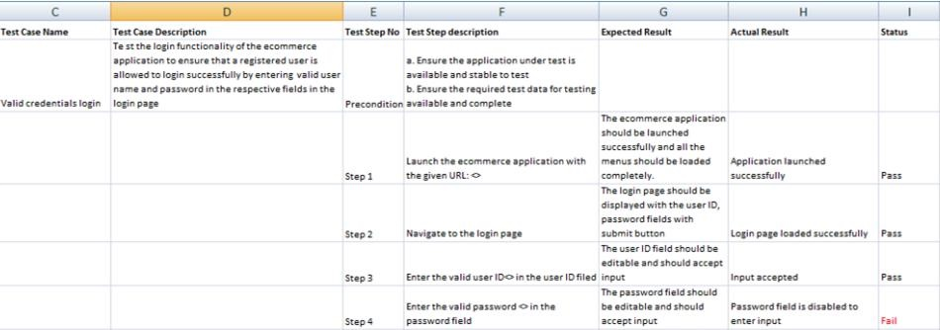
Front-End Testing
Better approach: Step-by-step script tests for errors
Low overhead & simple, but also easy to forget to run
Discover unexpected bugs by having testers run scripts
Good rules-of-thumb exist to find many common errors
List in task in ZenHub; many want files to hold scripts

Slide 108
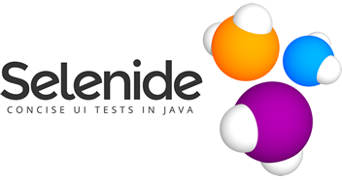


Validation Testing
Best approach: Automate testing with UI tool/code
Creates setup costs, but guarantees predictable results
Can compensate for load times & other real issues
Often include both programming & scripting setups

Slide 109
Selenium
Allows automated testing of web-based applications
Test suite reports results of running 1 or more tests
Often create many test cases; each exposes 1 bug
Add tests in Java/C#/Python with WebDriver module
Many languages have Selenium libraries to drive tests
Loads page & defines API used to evaluate its contents
If using IDE, able to create & runs in browser
IDE easier to use: can record actions in browser as test
Will also allow updating or rewriting Selenese script

Slide 110
Selenium IDE
Easiest module to use, but needs Chrome* to work
Download via Chrome Web Store to be ready to use
Scripts mostly recorded by clicking on elements to test
Start process using the command open to load page
click[AndWait] "clicks" on item that you identify
Script can also enter text into element using type
Like xUnit tests, relies on assertions to define checks
assertTitle checks title of page (text shown on tab)
Check if text on page using verifyTextPresent
verifyElementPresent checks if element on page

Slide 111
Selenium WebDriver + Java
public static void main(String[] args) {
WebDriver driver = new EdgeDriver();
driver.get("http://www.google.com");
WebElement el = driver.findElement(By.name("q"));
element.sendKeys("Hawaiian-Print Computer");
element.submit();
WebDriverWait stall = new WebDriverWait(driver, 10); boolean result = stall.until( new ExpectedCondition<Boolean>() {
public Boolean apply(WebDriver d) {
return d.getTitle().startsWith("Hawaiian");
}}); System.out.println("Met expectations: " + result);
driver.quit();
}

Slide 112
Selenium WebDriver + Python
driver = webdriver.Firefox()
driver.get("https://cse.buffalo.edu/~mhertz")
assert "Matthew Hertz" == driver.title
crselnk = driver.find_element_by_xpath( "/html/body/table[2]/tbody/tr/td[1]/p/a")
crselnk.click()
result = WebDriverWait(driver, 10).until( lambda x : "CSE442" in x.title)
assert result

Slide 113
Common Front-End Errors (1)
Input overflows: Type string longer than normal/fits
Check that text is accepted (or provides GOOD error)
If text is accepted, are results readable or usable?
Specify text (try many sizes) in scripts checking this

Slide 114
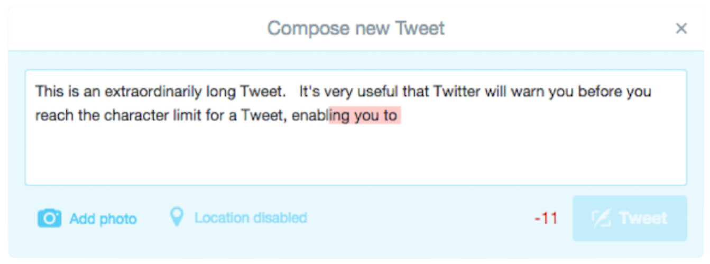
Common Front-End Errors (1)
Input overflows: Type string longer than normal/fits
Check that text is accepted (or provides GOOD error)
If text is accepted, are results readable or usable?
Specify text (try many sizes) in scripts checking this

Slide 115
Common Front-End Errors (2)
Structure overflow: Make panels larger than page
Does this create errors or is system able to handle data
Do items resize, scroll, or provide way to see everything?
Similar to loop tests; detailing inputs to use critical

Slide 116
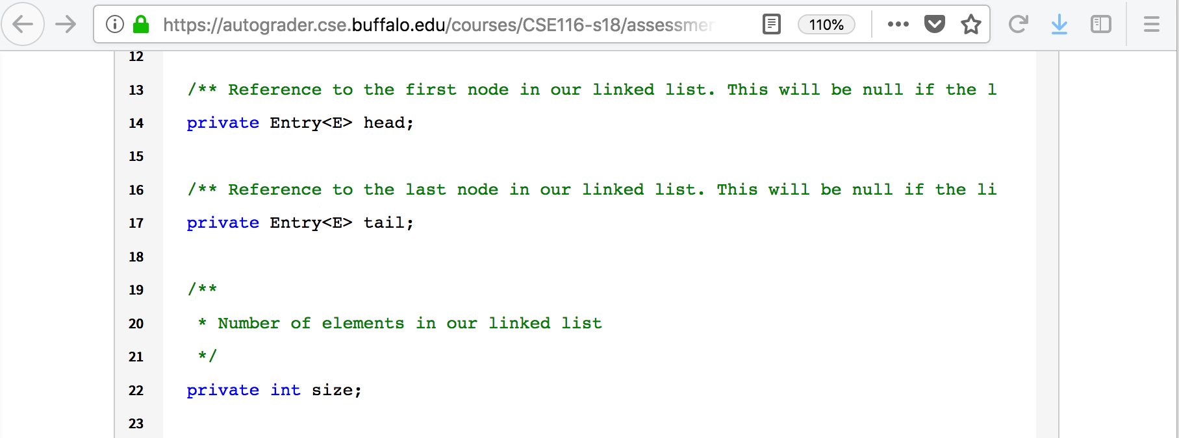
Common Front-End Errors (2)
Structure overflow: Make panels larger than page
Does this create errors or is system able to handle data
Do items resize, scroll, or provide way to see everything?
Similar to loop tests; detailing inputs to use critical

Slide 117
Common Front-End Errors (3)
Violate Assumptions: Assume users jerks (or dumb)

Slide 118
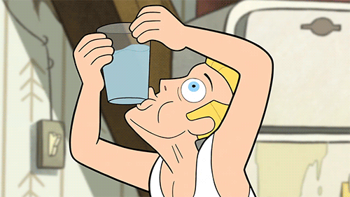
Common Front-End Errors (3)
Violate Assumptions: Assume users jerks (or dumb)

Slide 119
Common Front-End Errors (3)
Violate Assumptions: Assume users jerks (or dumb)
They will make worst choice.How does system react?
What if needed files deleted, network lost, or similar?
Script explain how to start & what error should be shown

Slide 120
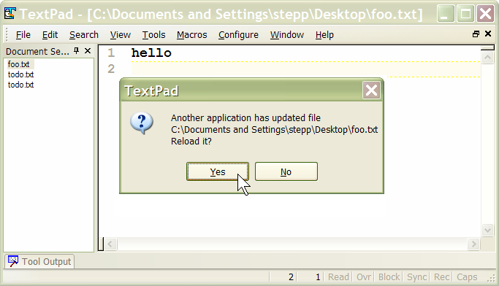
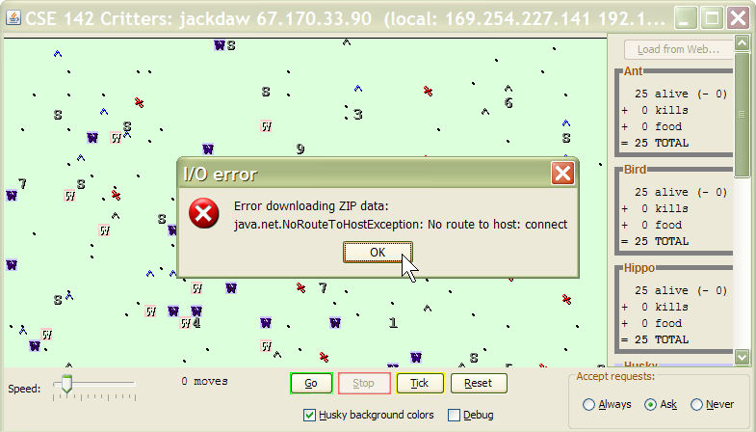
Common Front-End Errors (3)
Violate Assumptions: Assume users jerks (or dumb)
They will make worst choice. How does system react?
What if needed files deleted, network lost, or similar?
Script explain how to start & what error should be shown

Slide 121
Common Front-End Errors (4)
Duplication Issues: Repeatedly enter same input
If When they add/remove multiple times, what is error?
Does app handle (or provide clues) for impatient users?

Slide 122
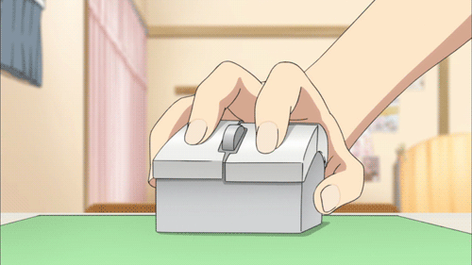
Common Front-End Errors (4)
Duplication Issues: Repeatedly enter same input
If When they add/remove multiple times, what is error?
Does app handle (or provide clues) for impatient users?

Slide 123
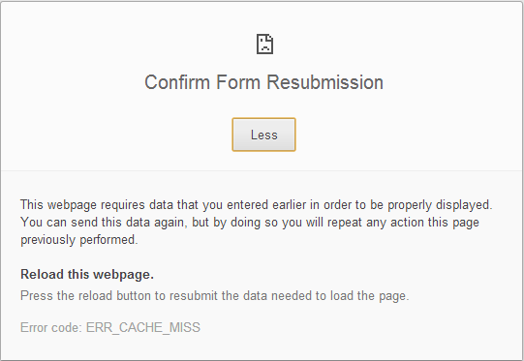
Common Front-End Errors (4)
Duplication Issues: Repeatedly enter same input
If When they add/remove multiple times, what is error?
Does app handle (or provide clues) for impatient users?
“Back” button tempting, what does it do to web app?

Slide 124
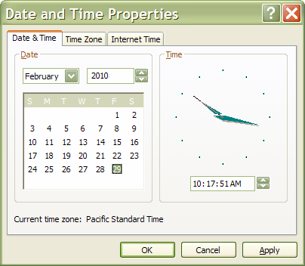
Common Front-End Errors (5)
Invalid Data: Intentionally force invalid results
Script actions creating illegal state in widget at the end
Feb 29 remain in non-leap years? Move start after end?
Give in to the dark side & trick system into bad states

Slide 125
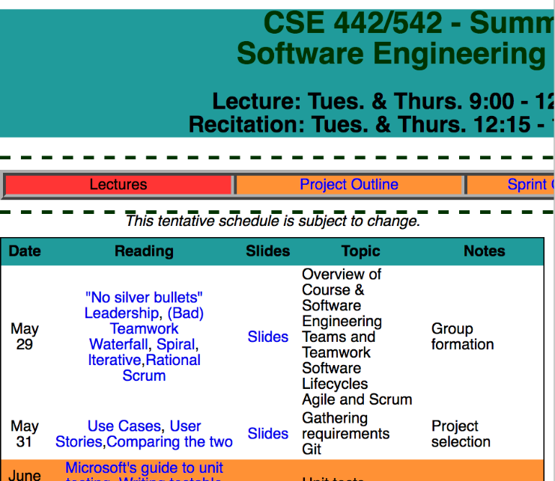
Common Front-End Errors (6)
Resizing issues: Can it handle different window sizes
Script resizing window & make sure program still usable
Set monitor to smaller screen & see if layout works
Try forcing scrollbar use & see how users will react

Slide 126

Non-UI JavaScript Testing

Slide 127
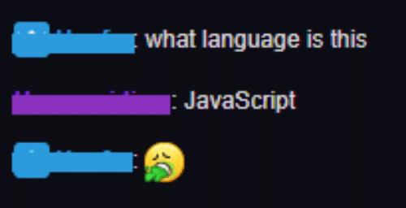
Non-UI JavaScript Testing
JavaScript is horrible, horrible language

Slide 128
Non-UI JavaScript Testing
JavaScript is horrible, horrible language
Brendan Eich created & implemented JS in 10 days
Name was stupid buzzword; never related to Java
Not intended as standard; Netscape looking to beat IE
"Standards" exist, but implementations vary greatly
Language combines many features to provide it all
OO, functional, or declarative code support exists
JS often implements middle-tier & front-end layers
Test different levels separately would be ideal, but how?

Slide 129
Non-UI JavaScript Testing
Real weakness of JS is difficulty in testing code
Not greatly used, but Mocha best unit testing library
Middle-tier tested via front-end in many/most situations
Not helpful to understand & fix, but should find bugs
Good language compiling to JS is alternate approach
Once complete, use tests and tools for original language
ScalaJS, TypeScript, & Dart developed for this purpose
All of this also assumes that bug not created by compiler

Slide 130

Other Testing Issues
Utility: Is it useable or need an ad with Seinfeld?

Slide 131
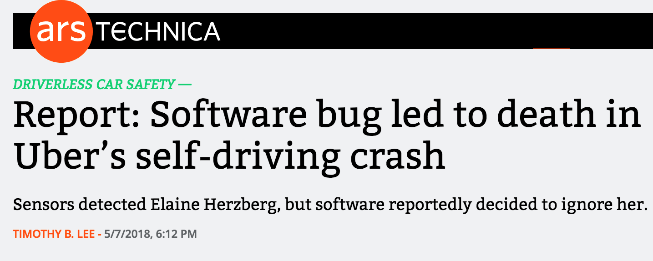
Other Testing Issues
Utility: Is it useable or need an ad with Seinfeld?
Reliability: Will you end up lead story on nightly news?

Slide 132

Other Testing Issues
Utility: Is it useable or need an ad with Seinfeld?
Reliability: Will you end up lead story on nightly news?
Robustness: How long of disclaimer will it need?

Slide 133

Other Testing Issues
Utility: Is it useable or need an ad with Seinfeld?
Reliability: Will you end up lead story on nightly news?
Robustness: How long of disclaimer will it need?
Performance: Will it finish before Buffalo wins title?

Slide 134
Key Point
=

